Slide 1
Section R.8
nth Roots;
Rational Exponents
Copyright © 2012 Pearson Education, Inc. Publishing as Prentice Hall.

Slide 2

Copyright © 2012 Pearson Education, Inc. Publishing as Prentice Hall.

Slide 3
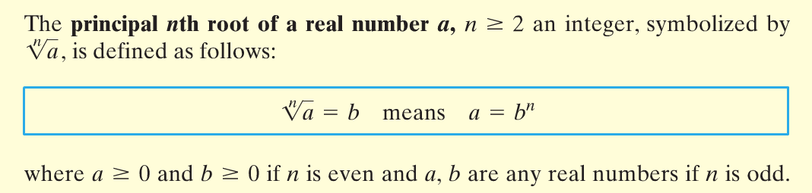
Copyright © 2012 Pearson Education, Inc. Publishing as Prentice Hall.

Slide 4

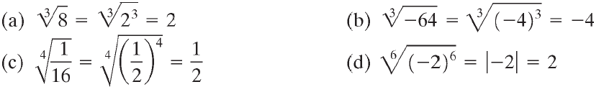




Copyright © 2012 Pearson Education, Inc. Publishing as Prentice Hall.

Slide 5
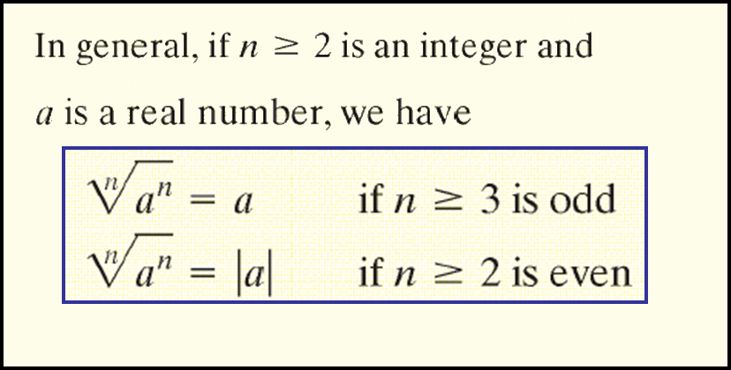
Copyright © 2012 Pearson Education, Inc. Publishing as Prentice Hall.

Slide 6
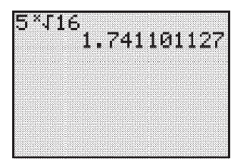
Copyright © 2012 Pearson Education, Inc. Publishing as Prentice Hall.

Slide 7

Copyright © 2012 Pearson Education, Inc. Publishing as Prentice Hall.

Slide 8

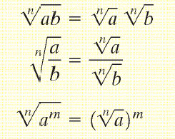
Copyright © 2012 Pearson Education, Inc. Publishing as Prentice Hall.

Slide 9

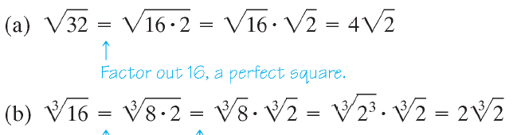
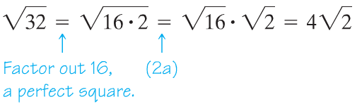
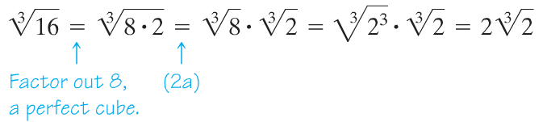
Copyright © 2012 Pearson Education, Inc. Publishing as Prentice Hall.

Slide 10

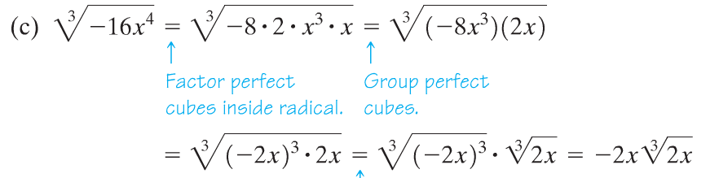

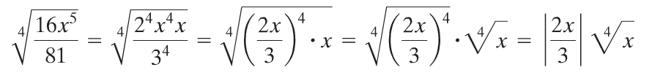
Copyright © 2012 Pearson Education, Inc. Publishing as Prentice Hall.

Slide 11








Copyright © 2012 Pearson Education, Inc. Publishing as Prentice Hall.

Slide 12

Copyright © 2012 Pearson Education, Inc. Publishing as Prentice Hall.

Slide 13
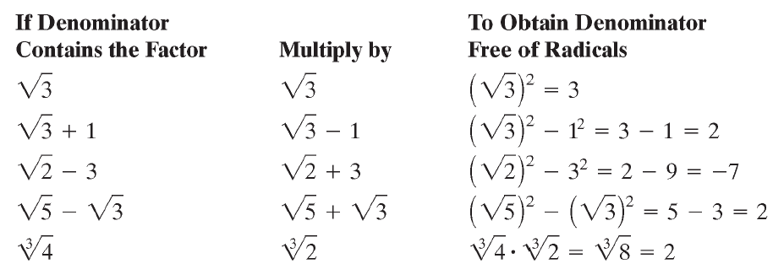
Copyright © 2012 Pearson Education, Inc. Publishing as Prentice Hall.

Slide 14

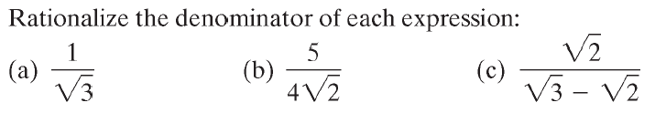
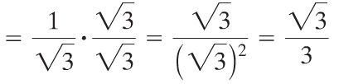
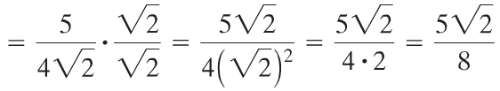

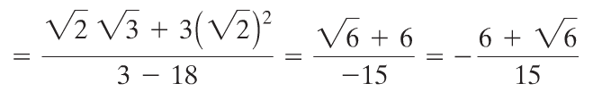
Copyright © 2012 Pearson Education, Inc. Publishing as Prentice Hall.

Slide 15
Copyright © 2012 Pearson Education, Inc. Publishing as Prentice Hall.

Slide 16
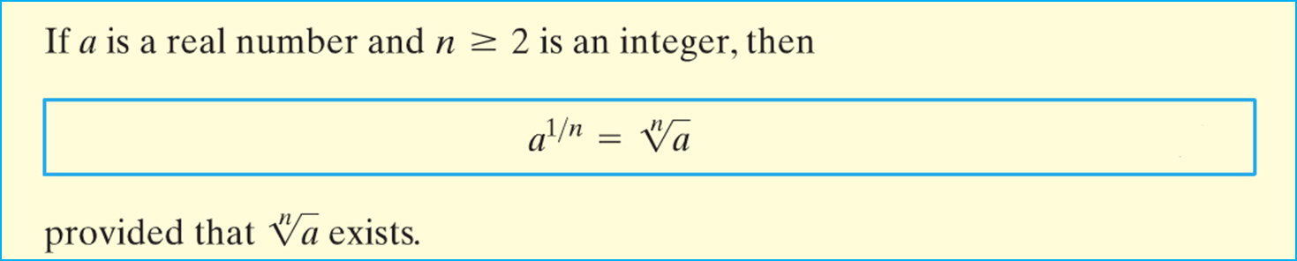
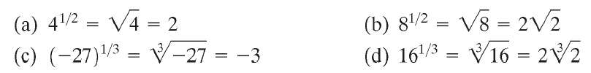




Copyright © 2012 Pearson Education, Inc. Publishing as Prentice Hall.

Slide 17
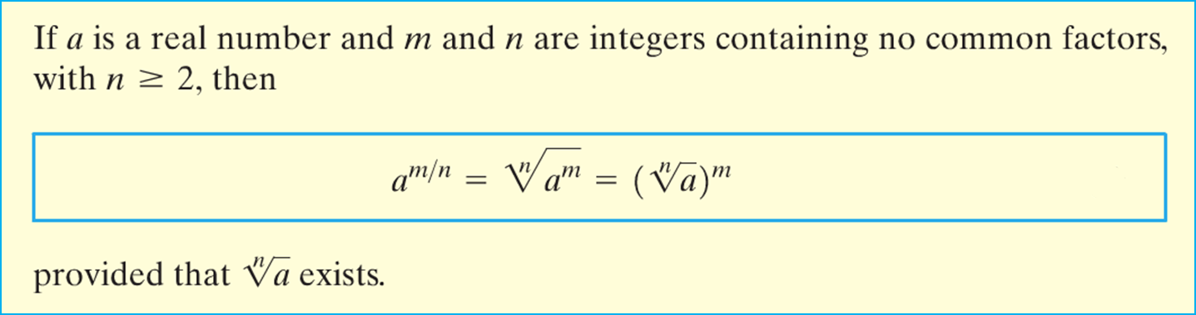

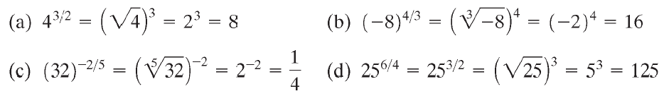




Copyright © 2012 Pearson Education, Inc. Publishing as Prentice Hall.

Slide 18
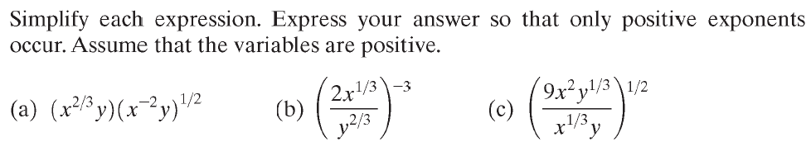





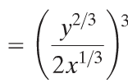
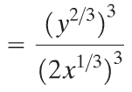
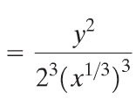

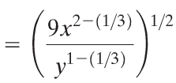
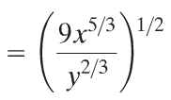
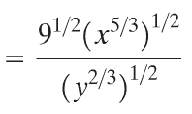

Copyright © 2012 Pearson Education, Inc. Publishing as Prentice Hall.

Slide 19
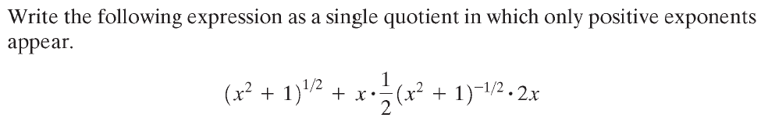


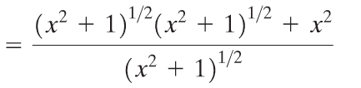
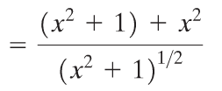

Copyright © 2012 Pearson Education, Inc. Publishing as Prentice Hall.

Slide 20




Copyright © 2012 Pearson Education, Inc. Publishing as Prentice Hall.

